Slide 1
Nx library
An introduction (by Ohhi.vn)

Slide 2
Agenda
Introduce about Ohhi.vn & me.
What is Nx library?
Some libraries for working with data & ML/AI.
Benefits of Nx.

Slide 3
Ohhi.vn
Started from 2023.
Came from Erlang’s world.
Focus to Elixir ecosystem.
Have some open source projects (https://github.com/ohhi-vn).
Try to make new funny thing for people.

Slide 4
About me
Experience:
Worked in security field in many years (CMC CyberSecurity, VinCSS).
Design & build SoC(log collecting & analysis - A kind of big data) from scratch for big corp.
Develop antivirus & security product (leader & main contributor).
Things are made by me:
CMC CryptoSHIELD (detect & protect pc out of ransomware).
Rule based detection engine for SoC.
Now
Interested in functional programing then go to work full time on Elixir/Erlang.

Slide 5
What is Nx (Numerical Elixir) lib?
A library for working with numerical & manipulating multidimensional data in Elixir.
A foundation for other libraries applied data analysis & ML/DL in Elixir.
(In Python’s world we have NumPy, in Elixir we have Nx)

Slide 6
Nx - Main things
Tensor hold data in multiple dimensions.
Operations for manipulating tensors: Nx.add, Nx.multiply, Nx.sum,...
defn for math expression.
Backend, where processing data.

Slide 7
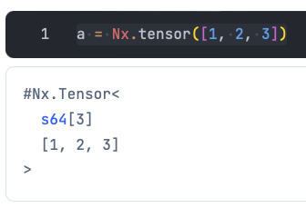
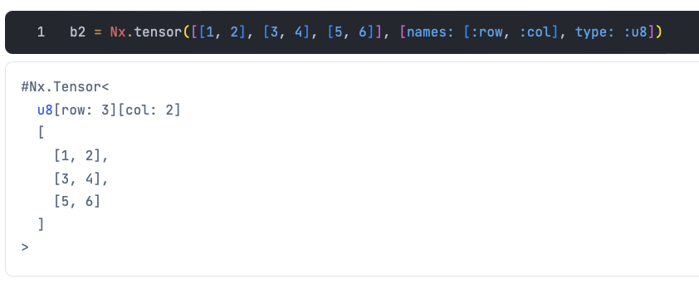
Nx - Tensor
Data in Nx is number (integer, float, brain float, complex) and tensor hold it in one or multidimensional.
Tensor can hold scalar(0 Dimension), vector(1 D), matrix(2 D), nd-array(n D) (mathematics name).

Slide 8
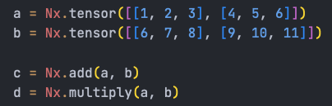
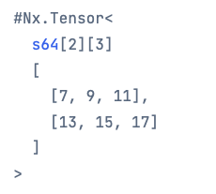
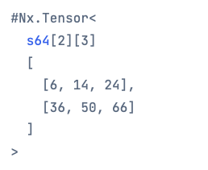
Tensor operations in Nx
Operation groups: Aggregating, Window, Cumulative,... in Nx can understand tensor and run faster than regular Elixir.

Slide 9
Nx - defn
A macro to wrap a expression of math formulas.
Very convenience for working with tensors.
Tensor ware, replace common operators in Kernel like: ‘Kernel.-/2’ by Nx Operations (optimized for tensors).
Compile from AST to target backend when function is called.
Import Nx.Defn for using.

Slide 10
Nx - Backends
Where the data will be processed.
Computing can run on CPU, GPU, TPU.
Some kind of backends:
BinaryBackend, default backend, pure Elixir implementation. Slow but can run everywhere.
EXLA, Elixir client for XLA (from Google).
TorchX, PyTorch Torch Script.
Nx support third party backends (means we can develop own backend).

Slide 11
Nx - Foundation for Data Analysis, ML & Deep Learning
Explorer: Creating and manipulating DataFrames (tabular data structures).
Axon: Creating and training neutral networks.
Scholars: Classic ML.
Bumblebee: Easy to pull & run model from Hugging Face (AI community).

Slide 12
Explorer - Intro
A library for processing data backed by Polars - A famous & blazing fast library (from Rust’s world) for manipulating structured data.
Bring Series, Dataframes & data analysis features to Elixir.
Support Parquet, CSV, NDJSON, Arrow IPC formats.

Slide 13
Axon - Intro
Pure Elixir interface for deep learning.
Build on top of Nx, don’t need too much work to build & run a neural network.
Can run model with ONNX (Open Neural Network Exchange) format through AxonOnnx.

Slide 14
Bumblebee - Intro
A wrapper of Axon.
A very convenience library for load & run model from Hugging Face.
Can run on LiveBook.

Slide 15
Demo
Some basic examples for easy understand Nx.

Slide 16
Benefits of Nx & libs
We don’t need go out to learn other languages/tools to develop data analysis or ML/DL then find a way to integrate it in your app.
We can run directly inside Elixir app, easy to deploy and reduce latency.
Save time & resource to develop product.
Easy to build develop a continuous training system for ML/AL.

Slide 17
Recommended docs
Sean Moriarity’s blog https://seanmoriaty.com
Sean Moriarity’s book Machine Learning in Elixir (on The Pragmatic Bookshelf).
Deep dive in Nx Backends (Paulo Valente) on Youtube.
Comparing Elixir and Python (A. Neto & L. C.) on Youtube.

Slide 18
Q & A
Thank you for listening!
Time for Q & A.

